Slide 1
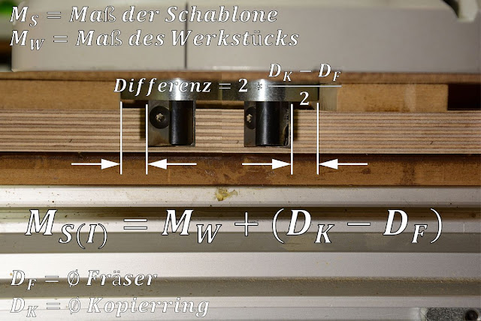
Width = 80 + (30 - 19) = 91
Height = 110 + (30 – 19) = 121

